Slide 1


Gapminder Dataset
My First EDA

Slide 2
What has been done here ?
The work done ahead by me was one of the work given to me under my coursework which was to to analyse this gapminder dataset and extract information and insights from this dataset.
Objective of the dataset was to extract what all information one can in order to see how one approaches and hence this Free data analysis or exploratory data analysis work was given.
Furthermore I have not just extracted information from the dataset but also digged the internet as to understand the extracted information in order to realise how the data was working and you will see this in the upcoming slides.

Slide 3
What has been done here ?
The work done ahead by me was one of the work given to me under my coursework which was to to analyse this gapminder dataset and extract information and insights from this dataset.
Objective of the dataset was to extract what all information one can in order to see how one approaches and hence this Free data analysis or Exploratory data analysis work was given.
Furthermore I have not just extracted information from the dataset but also digged the internet as to understand the extracted information in order to realise how the data was working and you will see this in the upcoming slides.

Slide 4

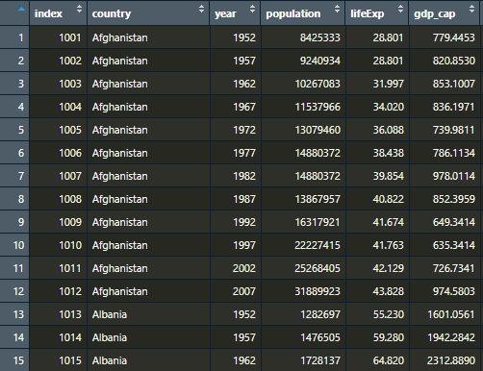
Dataset Contents
Overview
The Dataset provided was from the site of gapminder itself and usually this dataset contains data about countries and its various features like for instance here we have country with its life expectany and population and gdpcap and the data for each country for these parameters is from year 1952 to 2007 with an interval of 5 years between them so 1952 then 1957 and so on and so forth. Along with the main dataset a mapping dataset was also provided to map each country with its continent so as to perform analysis continent wise. Here’s a picture on how the data looks like.

Slide 5

01
World Population

Slide 6

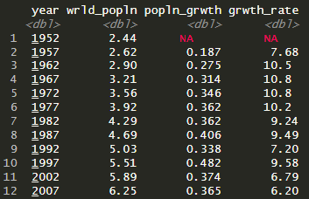
Population
Firstly I have calculated yearwise growth in world population and growth rate as well. (Billion)

Slide 7
Population
Looking at the data there is a growth in world population but a small blip comes in 1982 but the concerning dip comes between 1987 to 1992 and even 97 to 2002.
The reason ? My research said during this period there was substantial fertility decline in India and China and different Asian Countries as well as in Latin America. During these times the death rate were more in populous countries and birth rates were comparatively less than before.

Slide 8
02
Life Expectancy

Slide 9
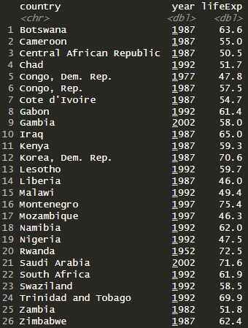
Life Exp
With respect to the life expectancy one thing I analyzed was do all countries had their best life expectancy in the most recent year present in the dataset which was 2007 as with increase in tech in medical field it is natural to assume that life expectancy to be the best of each country in the most recent year.
But that was not the case and there were 26 countries amongst the exceptions.

Slide 10
Life Exp
Now if we see in this list top 5 countries are African and majority of the countries in this list belong to Africa. This means they have a lesser life expectancy in 2007 proving a decline.
As far as Africa is concerned they had their best life expectancy between 1985 to 1990 but after that according to National Institutes of Health (NIH) in regions of Africa there was decline in life expectancy due to AIDS mortality.
Nowhere has the decrease in life expectancy been steeper and greater than in Southern Africa, where 40 years of increases in life expectancy were reversed in a period of 10 years.

Slide 11
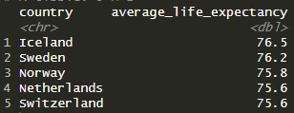
Life Exp
Further I have also checked countries with the best average life expectancy during the time period mentioned in the dataset.
By the looks of it European countries have faired out well here.

Slide 12
Mapping
As mentioned before we were provided with a mapping dataset as well which I used to map each country in the dataset with respect to their continent they belonged to.
Analysis ahead in accordance with continent.

Slide 13
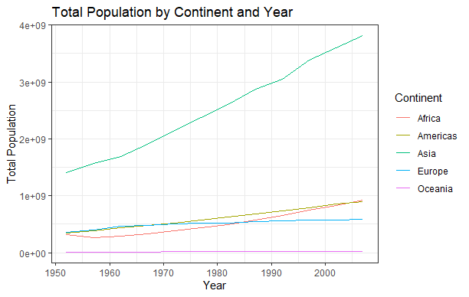
Year and Continent Popln
One can make out the population has always been high in Asiatic countries and technically it is the largest continent in the world so this was no surprise also the top 2 populous countries are present in Asia too.

Slide 14
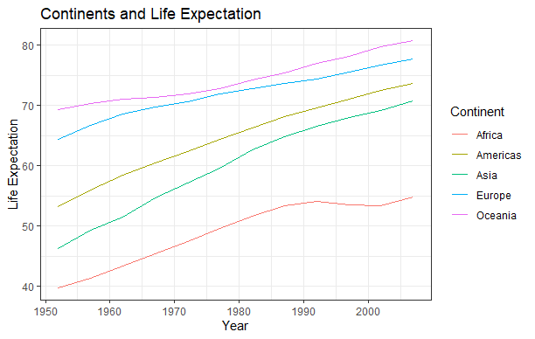
Year and Continent Life Exp
According to the previous findings Africa is way behind and this depicts that findings in an easier manner.

Slide 15
03
Super Powers

Slide 16
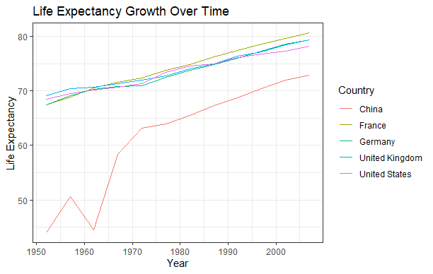
Life Expectancy
One can make out that most countries are on one and the same level with France doing really well but the country standing out here is China.
One can notice instability between 1955 and 1965. I found that during this period China faced Famine. The widespread starvation and significant reduction in calorie intake during the famine had a devastating impact on population health and led to a sharp increase in mortality

Slide 17
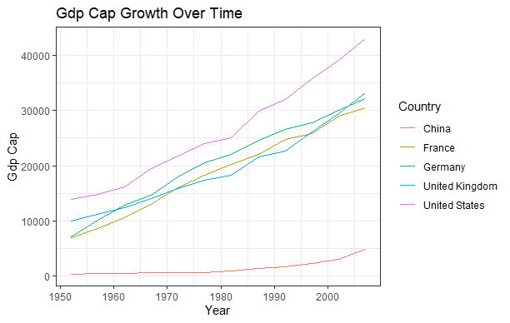
GDP Cap
GDP cap is an important indicator of economic performance and the US being a capitalist economy them performing well here is no surprise.
Again here China is a standout party. China's GDP per capita is relatively low due to several factors. One reason is the substitution bias in consumption, which has led to an underestimation of real GDP per capita by the World Bank. Additionally, the reliance on urban prices, which are higher than rural prices, has further contributed to the lower estimates.

Slide 18
04
I Love My India

Slide 19
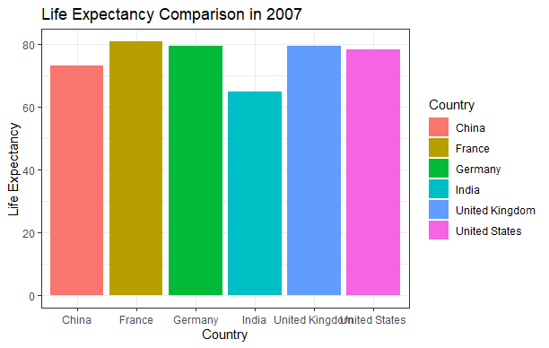
Life Exp
Further I am seeing how my country fairs out against these superpowers.
Looking at the graph life expectancy in 2007 India seems to be far off compared to these super powers.

Slide 20
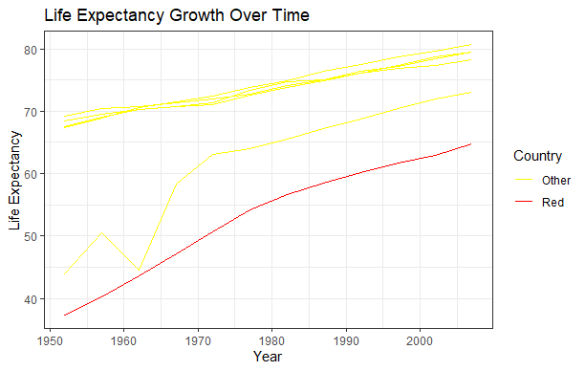
Life Exp
But looking at the line graph we can say that India’s growth has been stable unlike of China.
Red (India)
Yellow (Other Countries)
Further I am seeing how my country fairs out against these superpowers.
Looking at the graph life expectancy in 2007 India seems to be far off compared to these super powers.

Slide 21
Life Exp
But looking at the line graph we can say that India’s growth has been stable unlike of China.
Red (India)
Yellow (Other Countries)

Slide 22
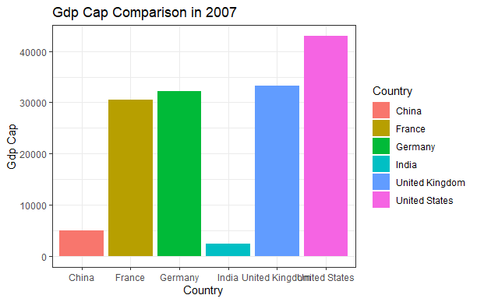
GDP Cap
In terms of GDP cap India as of in 2007 seems to be way far off against the super powers.
But taking a look on the line graph.

Slide 23
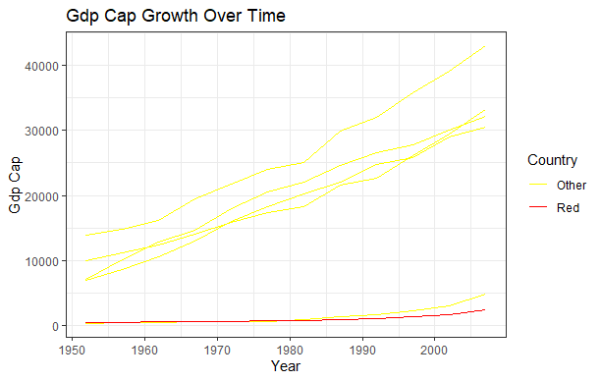
GDP Cap
Here in the line graph by the end of the line nearing to 2007 the line begins to rise.
This increase has been its most which was around 9.6% which was recorded impressive back then.
In terms of GDP cap India as of in 2007 seems to be way far off against the super powers.
But taking a look on the line graph.

Slide 24
GDP Cap
Here in the line graph by the end of the line nearing to 2007 the line begins to rise.
This increase has been its most which was around 9.6% which was recorded impressive back then.

Slide 25
05
My Continent

Slide 26
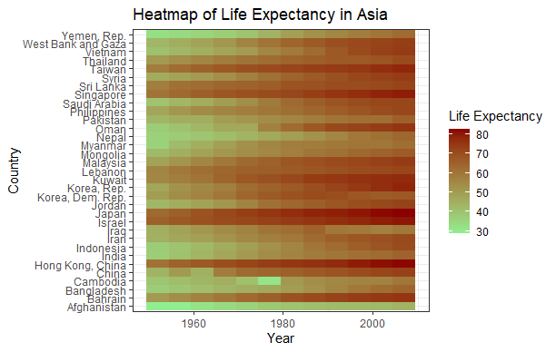
Japan, Israel and Hong Kong have great and steady life expectancy

Slide 27
Afghanistan throughout the tenure hasn’t experienced great life expectancy. This is mostly due to the fact of it being affected by terrorism.

Slide 28
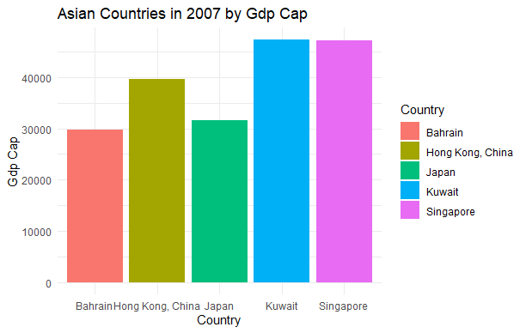
GDP Cap
Top 5 Asian countries in terms of GDP cap in 2007.
Kuwait and Singapore leading here as of 2007.

Slide 29
Vineet S. Poojary
Made By -

